Slide 1
Masked Face Recognition Ranked Signals

Slide 2
2023-2024

Slide 3
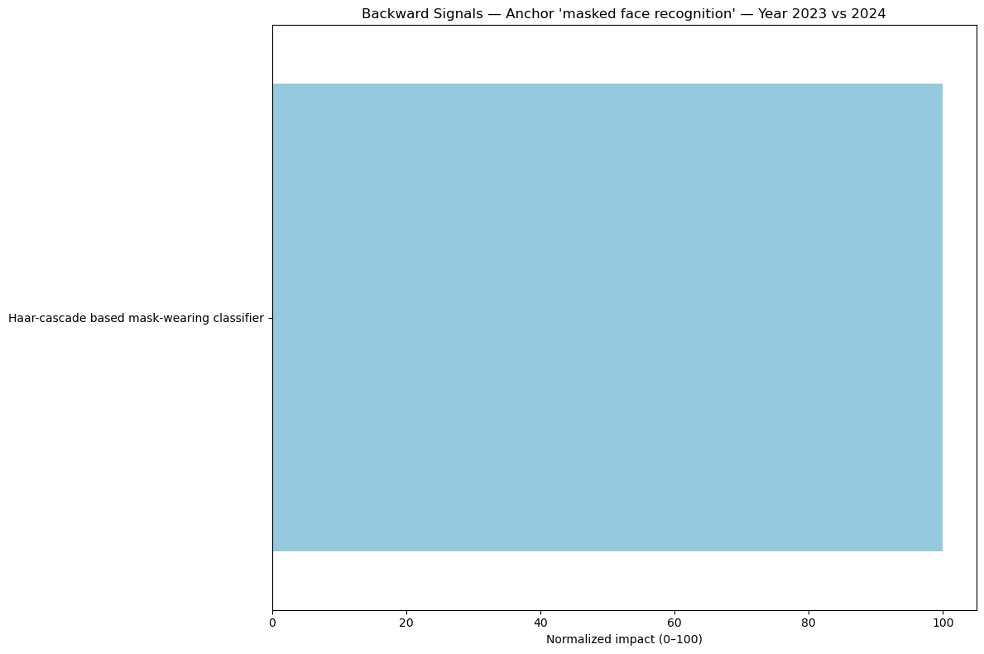

Slide 4
